Slide 1
Book store using mern stack
Angelin Gifty - 211521205016
Beautrin Snabel - 211521205023
Deepalakshmi - 211521205031
Harini - 211521205051

Slide 2
Abstract
A bookstore app built with the MERN stack (MongoDB, Express, React, Node.js) allows users to manage book data. The backend (Node.js/Express) connects to MongoDB for storing book info, while the frontend (React) provides a user interface to interact with the data. API requests are handled using Axios, creating a seamless experience for browsing, adding, and managing books.

Slide 3
Introduction
The MERN stack (MongoDB, Express, React, Node.js) is a popular way to build full websites. In this project, we will create a bookstore app using this technology. The app will let users add, view, update, and delete books.
The backend (using Node.js and Express) will handle requests from the user and connect to MongoDB, which stores the book data. The frontend (using React) will provide an easy-to-use interface for users to interact with the app. Axios will help get and send data between the frontend and backend.
This project shows how the MERN stack makes it easier to build websites where everything (data, server, and user interface) is connected using JavaScript.

Slide 4
Proposed system
The proposed system is a simple bookstore website using the MERN stack (MongoDB, Express, React, Node.js). It will allow users to:
Add books: Users can enter details like the book's title, author, price, and description.
View books: Users can see a list of all the available books with details.
Edit books: Users can update the information of any book.
Delete books: Users can remove books from the collection.

Slide 5
The system has:
A frontend (React) for users to interact with the website.
A backend (Node.js/Express) to handle requests and manage the data.
A database (MongoDB) to store the book details.
The app will be easy to use, with everything working together to manage the bookstore's data efficiently.

Slide 6
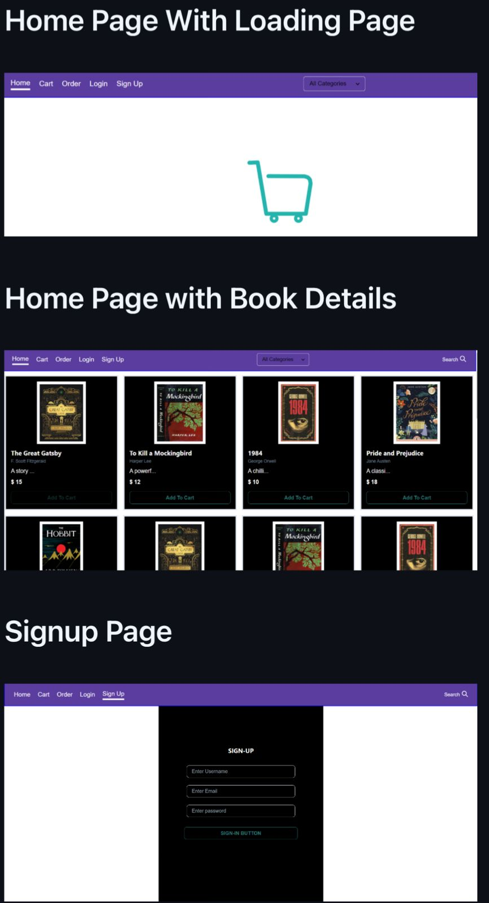
Screenshot of the model

Slide 7
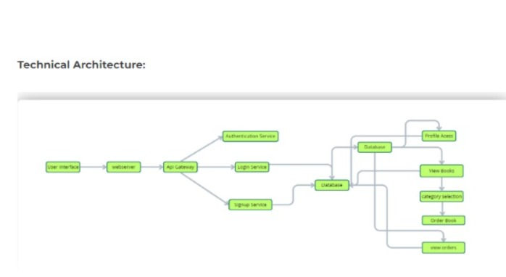

Slide 8
Conclusion
In conclusion, the bookstore app using the MERN stack is an easy and effective way to manage books online. With a simple interface for users to add, view, edit, and delete books, and a strong backend to handle the data, the system works well together. This project shows how the MERN stack can build complete and user-friendly web applications for managing tasks like a bookstore.

Slide 9
Thank you

